Slide 1
Unit VI: Files
Operating System Concepts

Slide 2
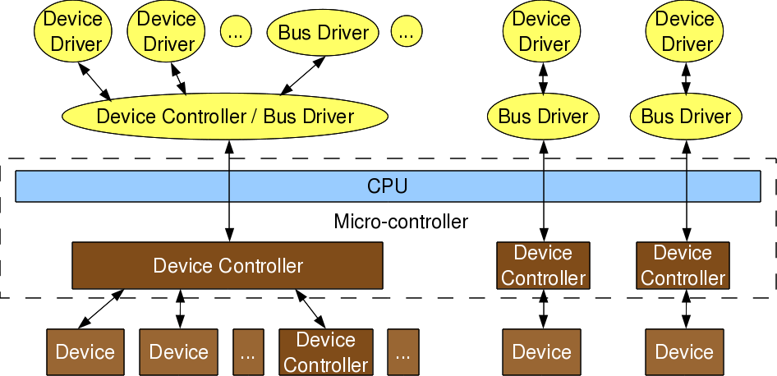
Device Drivers and Device controllers
Operating System Concepts

Slide 3
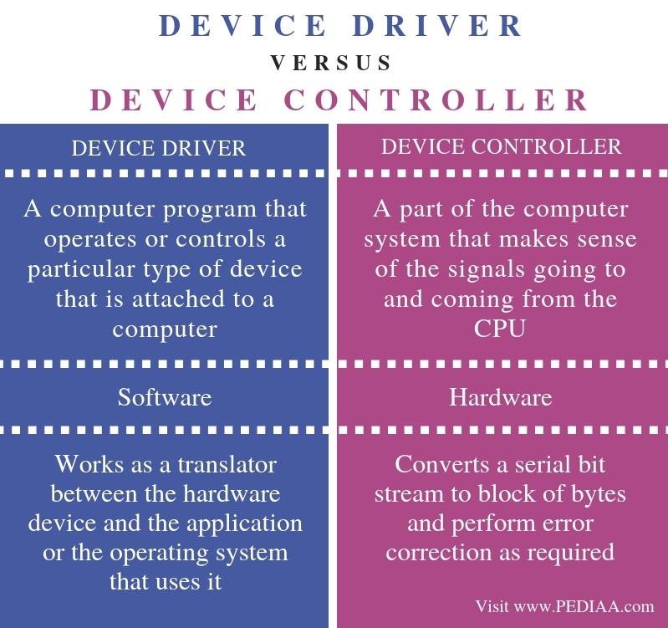
Operating System Concepts

Slide 4
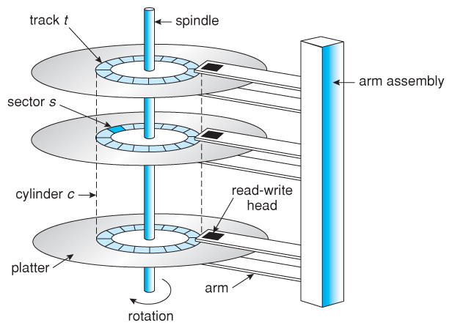
Disk Structure
Operating System Concepts

Slide 5
Disk Structure
Disk drives are addressed as large 1-dimensional arrays of logical blocks, where the logical block is the smallest unit of transfer.
The 1-dimensional array of logical blocks is mapped into the sectors of the disk sequentially.
  Sector 0 is the first sector of the first track on the outermost cylinder.
  Mapping proceeds in order through that track, then the rest of the tracks in that cylinder, and then through the rest of the cylinders from outermost to innermost.
Operating System Concepts

Slide 6
Disk Scheduling
The operating system is responsible for using hardware efficiently — for the disk drives, this means having a fast access time and disk bandwidth.
Access time has two major components
  Seek time is the time for the disk are to move the heads to the cylinder containing the desired sector.
  Rotational latency is the additional time waiting for the disk to rotate the desired sector to the disk head.
Minimize seek time
Seek time ≈ seek distance
Disk bandwidth is the total number of bytes transferred, divided by the total time between the first request for service and the completion of the last transfer.
Operating System Concepts

Slide 7
Disk Scheduling (Cont.)
Several algorithms exist to schedule the servicing of disk I/O requests.
We illustrate them with a request queue (0-199).
98, 183, 37, 122, 14, 124, 65, 67
Head pointer 53
Operating System Concepts

Slide 8

FCFS
Illustration shows total head movement of 640 cylinders.
Operating System Concepts

Slide 9
SSTF shortest seek time first
Selects the request with the minimum seek time from the current head position.
SSTF scheduling is a form of SJF scheduling; may cause starvation of some requests.
Illustration shows total head movement of 236 cylinders.
Operating System Concepts

Slide 10

SSTF (Cont.)
Operating System Concepts

Slide 11
SCAN
The disk arm starts at one end of the disk, and moves toward the other end, servicing requests until it gets to the other end of the disk, where the head movement is reversed and servicing continues.
Sometimes called the elevator algorithm.
Illustration shows total head movement of 321 cylinders.
Operating System Concepts

Slide 12
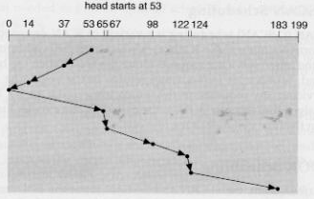
SCAN (Cont.)
Operating System Concepts

Slide 13
C-SCAN
Provides a more uniform wait time than SCAN.
The head moves from one end of the disk to the other. servicing requests as it goes. When it reaches the other end, however, it immediately returns to the beginning of the disk, without servicing any requests on the return trip.
Treats the cylinders as a circular list that wraps around from the last cylinder to the first one.
Operating System Concepts

Slide 14

C-SCAN (Cont.)
Operating System Concepts

Slide 15
LOOK
The disk arm starts from current position and moves toward the other end, as far as last request gets served, then it reverses the direction without going all the way to end serving the requests in the return trip.
Operating System Concepts

Slide 16
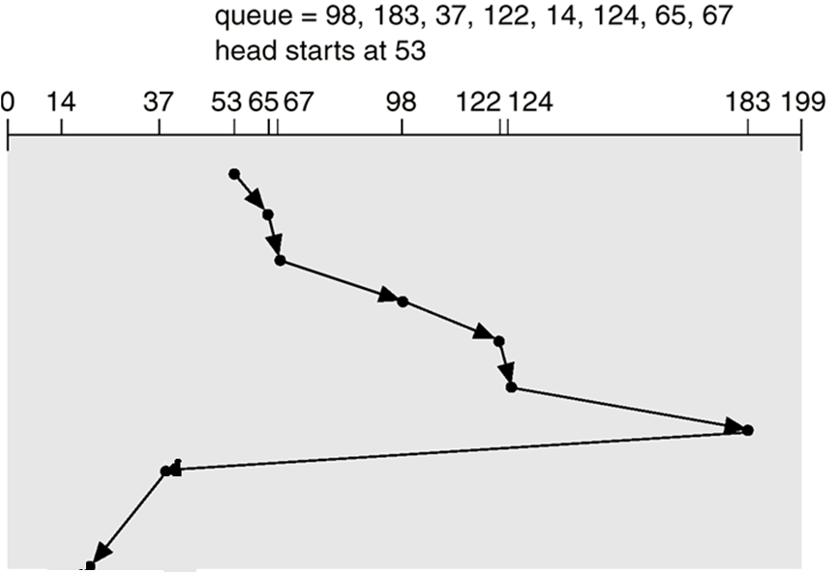
LOOK
Operating System Concepts

Slide 17
C-LOOK
Version of C-SCAN
Arm only goes as far as the last request in each direction, then reverses direction immediately, without first going all the way to the end of the disk.
Operating System Concepts

Slide 18

C-LOOK (Cont.)
Operating System Concepts

Slide 19
Selecting a Disk-Scheduling Algorithm
SSTF is common and has a natural appeal
SCAN and C-SCAN perform better for systems that place a heavy load on the disk.
Performance depends on the number and types of requests.
Requests for disk service can be influenced by the file-allocation method.
Operating System Concepts

